Slide 1
EU409
Basic Economic Concepts for European Political Economy
Household decisions – microeconomics

Slide 2
Aims
Our first look at micro-economics
The four economic choices of households
  Four cases of constrained optimisation
Introducing new concepts and analytical tools
Key concepts
  Utility, preferences, indifference, maximisation
  Income and substitution effects (of a price-change)
  Normal, superior and inferior goods
  Income and price elasticities

Slide 3
The basics: preferences (indifference curves) and budget constraints

Slide 4
The budget line
Consider a student with a budget of £50 to spend on
meals and films
Income and prices together determine the combinations of the goods that the consumer can afford
The budget line separates the affordable from the unaffordable
7
6
5
4
3
2
1
0
Quantity of films
A
C
D
B
0 1 2 3 4 5 6 7 8 9 10
Quantity of meals
Price of films is £10
Price of meals is £5
Its slope gives us the relative price of each good!

Slide 5
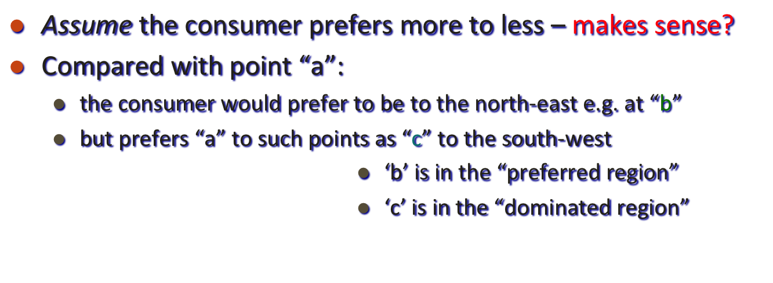
Modelling consumer preferences
Preferred
region
Quantity of films
“a” is preferred to all points in the dominated region
but it is inferior to any point in the preferred region
What about points ‘d’ or ‘e’???
they involve more of one good and less of the other compared with “a”: how can we decide?
d
b
a
c
Dominated
region
e
Quantity of meals

Slide 6
Modelling consumer preferences
An indifference curve like U₂U₂ shows all the consumption bundles that yield the same utility to the consumer (note: marginal rate of substitution)
  ICs slope downwards (given our assumptions) – why?
  their slope gets steadily flatter to the right –why?
  ICs cannot intersect –why?
  Assume UU
    In UU, A and B indifferent
    In U₂U₂, A and C indifferent
    But B clearly preferable to C!!!
U₂
U
Quantity of films
B
C
A
U₂
U
Quantity
of meals

Slide 7
Modelling consumer preferences
Draw ICs for the following:
  I don’t like oranges
  I like apples and oranges equally
  (substitutes)
  I only like apples when having them with oranges
  (complements)
Quantity of oranges
Quantity
of apples

Slide 8
The consumer’s choice
Constrained maximisation
Constrained: means are limited (recall scarcity); cannot have endless amounts
  of X & Y; have to trade-in one for the other; there is a budget constraint
- Maximisation: find the right combination of X & Y that gives maximum utility
The point at which utility is maximised is found
by bringing together the ICs and the budget line
Given your budget BL…
…the choice point is at C
where the budget line is at a tangent to an IC
Points B and E are also affordable
but give lower utility,
being on a lower IC
Point F is more desireable
but also non-affordable…
U₃
U₂
U₁
Quantity of films
B
F
C
U₃
E
U₂
BL
U₁
Quantity of meals

Slide 9
Analysis of constrained optimisation (consumer choice)

Slide 10
Analysis of constrained optimisation
Four main economic decisions of households
…in one single analysis!
1 & 2: Determining the size of the budget for present consumption
(1) by supplying labour to firms
(2) by saving for future spending
3: Allocating a given budget on present consumption (across goods)
4: Managing economic uncertainty by insuring against risks
And more: Whether to invest in education, take early retirement, hire a nanny, etc…

Slide 11
(1) Labour supply (allocating time)
Maximisation problem: allocate your given time (24hrs a day) such that you get maximum utility!
Constraint and the budget line: 24hrs in a day, which can be transformed into / exchanged with income/work at a rate (marginal rate of transformation) which is given the hourly wage
Income
Income earned with 24 hrs of work
Y*
Utility (ICs – marginal rate of substitution): it depends on how much ‘joy’ you get
- out of leisure
- from (the income you
generate by) working
We’ll get back to this later
X*
Leisure
(in hrs)
24hrs

Slide 12
(2) Saving (allocating C over time)
Allocate your income between the present and the future such that you get maximum utility from inter-temporal consumption!
Constraint = all your income across time – future and present exchangeable depending on the interest rate at which you can lend and borrow (assumes perfect markets and full-info!)
Utility – depends on how much happiness you get from consumption in the different time periods (your time preferences; or, put differently, your future-discount rate)
Future spending
Y*
X*
Current spending

Slide 13
(3) Consumption (allocation bw goods)
Allocate your given budget for present consumption such that you get maximum utility out of the consumption of quantities X* and Y*!
Constraint = all your present income – trade-off between the goods subject to their prices
Utility – depends on the utility you get from each
Food
Y*
Clothing
X*

Slide 14
(4) Insurance against risks (investment)
Allocate your state-contingent income (in Good or Bad times – or between consumption and investment) such that you get maximum utility out of your planned but uncertain spending
Income in state G
Y*
What is the constraint here???
X*
Income in state B

Slide 15
A bit more on labour supply
(and the derivation of demand/supply curves at the price-product space)

Slide 16
Deriving the labour supply curve
Daily income
Upward sloping: substitution > income effect
Backward bending: income effect dominates
Wage rate
Leisure
Hours worked

Slide 17
The position of the labour supply curve
Constrained by the maximum working hours per day/week
Depends on the reservation wage
Depends on other outside opportunities (U-benefits)
Depends on payroll taxes
Wage rate
→ A similar analysis derives the
savings curve (upward sloping
with the interest rate –see week 3)
Hours worked

Slide 18
Analysis of consumption decisions: changes in incomes and prices

Slide 19
Adjustment to an income change
A change in the consumer’s income shifts the budget line
without changing the slope
the change in the pattern of consumer choice depends on the nature of the two goods (normal, inferior, superior)

Slide 20
Normal goods
Normal goods:
When income (the means to buy goods) rises, demand for a normal good rises proportionally
BL₁
U₂
U₁
When both goods are
NORMAL, an increase
in income induces a new
choice point at C':
Films
BL₀
C'
The quantity demanded
of each good increases
C
U₂
U₁
Meals

Slide 21
An inferior good and a normal good
Inferior goods:
As income rises, consumption opportunities improve and preferences for previously unaffordable goods can now be satisfied; consumption of more basic (inferior) goods declines in absolute terms
BL₁
U₂
U₁
Films
When “meals” is an inferior good
the increase in income takes the
consumer from C to C'.
BL₀
C'
The quantity of meals falls
U₂
C
and the quantity of films increases
U₁
Superior: increase
with income more
than proportional
Meals

Slide 22
Adjustment to a price change
An increase in the price of one good shifts the budget line
  altering its slope
  which reflects relative prices

Slide 23
An increase in the price of meals (1)
The increase in price of meals shifts the
budget line from BL₀ to BL₁
Films
BL₀
BL₁
Meals
The increase in price reduces purchasing power
(if and only if the consumption basket includes ‘meals’)

Slide 24
An increase in the price of meals (2)
U₂
The consumer moves from
the original choice point C
Films
U₁
to a new position at E.
C
U₂
E
U₁
BL₁
BL₀
Meals
Tracing out more of such points at different prices
enables us to identify the Demand curve.

Slide 25
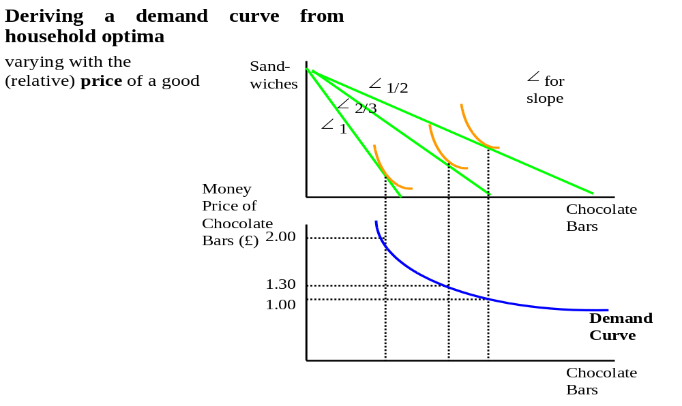
Deriving market demand

Slide 26
A closer look at the effect of price changes
What happens if food becomes more expensive?
>> the purchasing power of your income changes – if you buy any food at all, the price change will shrink your consumption bundle
>> notice we get on a lower utility curve
>> the rate at which you can trade off food against clothing changes
>>> how do you react?
  >> shrinking your consumption
  >> regrouping spending from food to clothing
Films
E
C
Y*
BL₁
X*
BL₀
Meals

Slide 27
Response to a price change
The response to a price change comprises two effects:
The SUBSTITUTION EFFECT
  is the adjustment to the change in relative prices
THE INCOME EFFECT
  is the adjustment to the change in real income

Slide 28
The income and substitution effects
H
As noted, the consumer moves from C to E – but how?
U₂
First change the slope of the budget line along the existing IC:
  The hypothetical budget line HH has the slope of the NEW relative prices but is tangent to the OLD indifference curve
  At point D, we have substituted the rising-price good with the price-constant good, while keeping our utility at a constant level
Then look at the effective income fall:
  HH moves to BL₁ to reflect the fall in income
Films
U₁
D
C
E
U₂
U₁
H
Meals
BL₁
BL₀
The move from C to D along U₂U₂ is the SUBSTITUTION EFFECT
  It is always negative: a price increase leads to a fall in demand
The move from D to E down to U₁U₁ is the INCOME EFFECT
  It reflects the fall in real income at constant relative prices
  It may be +ve or –ve, depending on whether the good is normal or inferior (if inferior, consumption due to the income effect will go up)

Slide 29
Some last points
On the intuition of the theory

Slide 30
The price elasticity of demand
…measures the sensitivity of the quantity
demanded of a good to a change in its price
It is defined as:
% change in quantity demanded
% change in price

Slide 31
Demand elasticity
ELASTIC demand
  when the price elasticity is more negative than -1
  (when the change in quantity demanded exceeds the change in price)
  if demand falls by 7% in response to a 5% price rise, elasticity is -7/5=-1.4
INELASTIC demand
  when the price elasticity lies between -1 and 0
  (when change in quantity demanded smaller than the change in price)
  if demand falls by 3.5% due to a 5% price rise, elasticity is -3.5/5=-0.7
UNIT-ELASTIC demand
  when the price elasticity is exactly -1
  (when the change in quantity demanded equals the change in price)
  if demand falls by 5% in response to a 5% price rise, elasticity is -5/5=-1.0

Slide 32
Price elasticity
for a linear demand curve
The price elasticity varies along the length of a
straight-line demand curve.
Price
Elastic
Unit elasticity
Inelastic
Demand
Quantity

Slide 33
What determines the price elasticity?
The ease with which consumers can substitute another good
  Across products
    if consumers can readily substitute one brand of detergent for another, expect demand to be elastic
    but if all detergent prices rise (no substitutes), the consumer cannot switch: expect inelastic demand
  Over time
    If price changes persist, consumers are more likely to adjust their expenditure patterns
    Demand thus tends to be more elastic in the long run but relatively inelastic in the short run

Slide 34
Revisiting substitutes/complements and normal/inferior goods
Cross-price elasticity of demand
  Change in demand for i due to change in price of j
  Can be positive or negative
    Cross-price elasticity is negative if goods are substitutes
    Cross-price elasticity is positive if goods are complements
  Examples: coffee and tea (subs); coffee and milk (complements)
Income elasticity of demand
  Measures the demand-sensitivity of changes in income
  Change in demand for i due to a change in income
  Can be positive or negative
    Income elasticity is positive if the good is normal (e.g., cheese)
    Income elasticity is negative if the good is inferior (e.g., lard)
    Income elasticity is greater than 1 for luxury goods (e.g., gold)

Slide 35
Income and the demand curve
For an increase in income:
NORMAL GOOD
INFERIOR GOOD
Price
Price
D₀
D₁
D₁
D₀
Demand curve
moves to the right
Quantity
Quantity
Demand curve
moves to the left

Slide 36
Summary
Budget line and indifference curves: relative prices and marginal rate of substitution
Analysis of consumer choice: constrained maximisation – applies to all choice decisions
Adjustment to income changes: normal and inferior goods
Analysis of price changes: income and substitution effects
Deriving aggregate supply (+savings): upward sloping and backward bending
Price, cross-price and income elasticities

